Slide 1

Literature
Review
GROUP DSA_202101_ 4

Slide 2

Number of research we used in this Literature Review
Intelligent chatbot model to enhance the emotion detection in social media using bi-directional recurrent neural network
Two Research papers
Analytical and Sentiment based text generative chatbot

Slide 3

Number of research we used in this Literature Review
Paper 01
Intelligent chatbot model to enhance the emotion detection in social media using bi-directional recurrent neural network

Slide 4
Research Goal
Paper 01
Develop a chatbot that detects emotions
Intelligent chatbot model to enhance the emotion detection in social media using bi-directional recurrent neural network

Slide 5
Research Goal
Paper 01
Develop a chatbot that detects emotions
and based on these emotions, the chatbot suggests a song .
Intelligent chatbot model to enhance the emotion detection in social media using bi-directional recurrent neural network

Slide 6
Applied Methods
Paper 01
Data set certation and preprocessing
There are 2 phases in this system
Part 1: sentiment analysis methods with classification algorithms
1-SVM
2-linear regression
3-Naive Bayes
Part 2: chatbot method -Bi-directional recurrent neural network (BRNN) algorithm.
Intelligent chatbot model to enhance the emotion detection in social media using bi-directional recurrent neural network

Slide 7



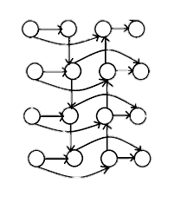
Applied Methods
Paper 01
CHATBOT
Data set certation and preprocessing
GUI
There are 2 phases in this system
Part 1: sentiment analysis methods with classification algorithms
1-SVM
2-linear regression
3-Naive Bayes
Part 2: chatbot method -Bi-directional recurrent neural network (BRNN) algorithm.
Dataset
ChatBot
1
Data preprocessing
Hi…
2
Hi, what’s up
It was a tough day
Preprocessed Data
Wanna listen to some music!
Yup
4
3
Training
Testing
BRNN
5
7
8
6
Chatbot Model
Intelligent chatbot model to enhance the emotion detection in social media using bi-directional recurrent neural network

Slide 8
Applied Methods
Paper 01
CHATBOT
SENTIMENT ANALYSIS
Data set certation and preprocessing
GUI
There are 2 phases in this system
Part 1: sentiment analysis methods with classification algorithms
1-SVM
2-linear regression
3-Naive Bayes
Part 2: chatbot method -Bi-directional recurrent neural network (BRNN) algorithm.
Dataset
Dataset
ChatBot
1
9
10
Data preprocessing
Hi…
2
Hi, what’s up
It was a tough day
Training
Testing
Preprocessed Data
Wanna listen to some music!
Yup
11
4
3
Lexicons/Bag of words
Training
Testing
BRNN
5
7
12
13
8
14
6
Chatbot Model
15
Sentiment analysis model
Intelligent chatbot model to enhance the emotion detection in social media using bi-directional recurrent neural network

Slide 9
Research Results
Paper 01
Final results was a chatbot have capabilities to detect the emotions of users
Intelligent chatbot model to enhance the emotion detection in social media using bi-directional recurrent neural network

Slide 10

Research Results
Paper 01
Final results was a chatbot have capabilities to detect the emotions of users
BUT
without any providing of model accuracies or test results
Intelligent chatbot model to enhance the emotion detection in social media using bi-directional recurrent neural network

Slide 11

Paper Claims
Paper 01
The authors assumed that Bi-directional Recurrent Neural Network could be the best choice to train the chatbot.
Combining this chatbot with sentiment analysis would enhance the emotions detection of users.
Intelligent chatbot model to enhance the emotion detection in social media using bi-directional recurrent neural network

Slide 12
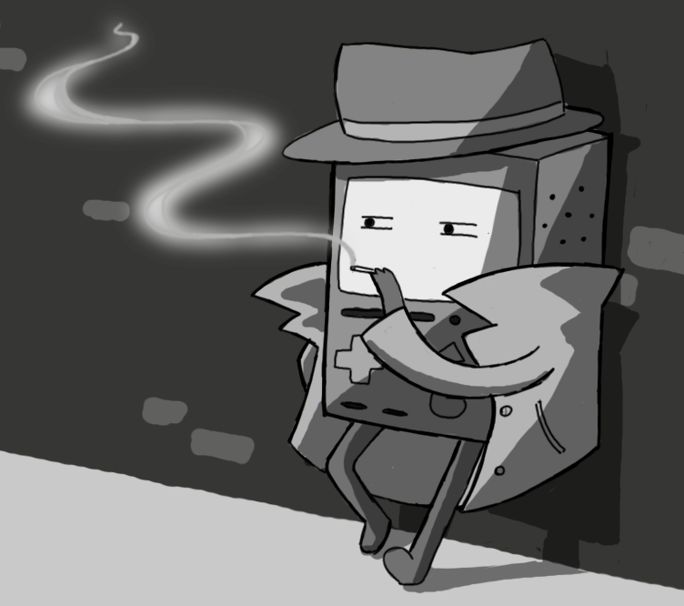
Paper Claims
Paper 01
The authors assumed that Bi-directional Recurrent Neural Network could be the best choice to train the chatbot.
Combining this chatbot with sentiment analysis would enhance the emotions detection of users.
The claim have no support from authors
Intelligent chatbot model to enhance the emotion detection in social media using bi-directional recurrent neural network

Slide 13
Paper Claims
Paper 01
The authors assumed that Bi-directional Recurrent Neural Network could be the best choice to train the chatbot.
Combining this chatbot with sentiment analysis would enhance the emotions detection of users.
The claim have no support from authors
NO Providing
Chat samples
Accuracies results
Intelligent chatbot model to enhance the emotion detection in social media using bi-directional recurrent neural network

Slide 14
Paper Claims
Paper 01
Missing results
The authors assumed that Bi-directional Recurrent Neural Network could be the best choice to train the chatbot.
Combining this chatbot with sentiment analysis would enhance the emotions detection of users.
No providing of evaluation metrics like accuracies and graphs.
No providing of which classification model they used in sentiment analysis model and they didn’t compare between the suggested model.
The claim have no support from authors
Intelligent chatbot model to enhance the emotion detection in social media using bi-directional recurrent neural network

Slide 15
Paper Claims
Paper 01
The authors assumed that Bi-directional Recurrent Neural Network could be the best choice to train the chatbot.
Combining this chatbot with sentiment analysis would enhance the emotions detection of users.
Missing claims
No providing of all dataset sources.
No suggestion of other models to train the chatbot.
The claim have no support from authors
Missing results
No providing of evaluation metrics like accuracies and graphs.
No providing of which classification model they used in sentiment analysis model and they didn’t compare between the suggested model.
Intelligent chatbot model to enhance the emotion detection in social media using bi-directional recurrent neural network

Slide 16
Reasonable Next Steps
Paper 01
Using different models to train the chatbot like
  LSTM
  BERT
Comparing between different sentiment analysis models and provide all accuracies and results
Intelligent chatbot model to enhance the emotion detection in social media using bi-directional recurrent neural network

Slide 17

Paper 02
Analytical and Sentiment based text generative chatbot

Slide 18
Research Goal
Paper 02
Building a chatbot which generates responses on the basis of the emotions of the users in order to recreate a more sympathetic and human-like aspect towards the user.
It wasn’t my day
Analytical and Sentiment based text generative chatbot

Slide 19
Research Goal
Paper 02
Building a chatbot which generates responses on the basis of the emotions of the users in order to recreate a more sympathetic and human-like aspect towards the user.
It wasn’t my day
I’m so sad today
Analytical and Sentiment based text generative chatbot

Slide 20
Applied Methods
Paper 02
“ I don’t feel so good today ”
Preprocessing of Data
Removing stopwords
“ I don’t feel good today ”
Removal of Stopwords
Removing Punctuations and acronyms
“ dont feel good today ”
Removing punctuations and acronyms
Tokenizing
Tokenization
[“dont”, “feel”, “good”, “today”]
Stemming
Stemming
[“dont”, “feel”, “good”, “today”]
Porter’s Stemming Algorithm
Lovins Stemmer
Dawson Stemmer
Krovetz Stemmer
Analytical and Sentiment based text generative chatbot

Slide 21
Applied Methods
Paper 02
Proposed Model
Preprocessing of Data
Removal of Stopwords
The deep feed forward neural net used in the model
consists of 3 hidden layers consisting of 420, 256 and 64
neurons in each layer respectively. The output layer neurons
are adjusted according to the tags so that, had the dataset be
modified the newly added tags will be incorporated while
training the model on it. The hidden layers use the ReLU
activation function and the output layer consists of the
Softmax function
Removing punctuations and acronyms
Tokenization
Stemming
Analytical and Sentiment based text generative chatbot

Slide 22
Applied Methods
Paper 02
Comparison of optimizers
Preprocessing of Data
Removal of Stopwords
Removing punctuations and acronyms
The model have tested on two optimizers: Adam and Stochastic Gradient Descent (SGD), for 100 epochs on the same dataset.
Upon observation it can be concluded safely that Adam
is a better suited optimizer for the model over SGD.
Tokenization
Stemming
Proposed Model
The deep feed forward neural net used in the model
consists of 3 hidden layers consisting of 420, 256 and 64
neurons in each layer respectively. The output layer neurons
are adjusted according to the tags so that, had the dataset be
modified the newly added tags will be incorporated while
training the model on it. The hidden layers use the ReLU
activation function and the output layer consists of the
Softmax function
Analytical and Sentiment based text generative chatbot

Slide 23
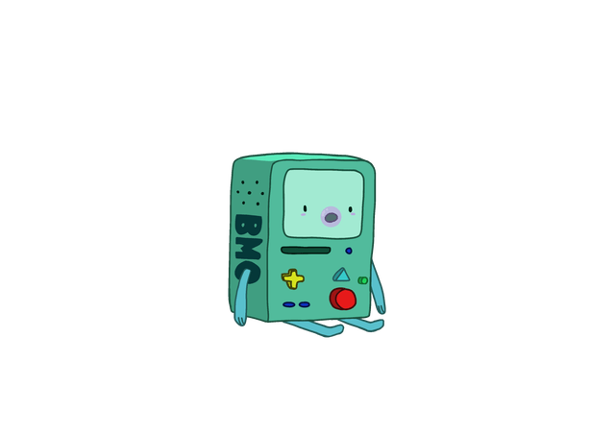
Research Results
Paper 02
Exceptionally chatbot fluent and in the range of 50 milliseconds with generated accurate text to the accuracy of 93.45%.
Analytical and Sentiment based text generative chatbot

Slide 24
Paper Claims
Paper 02
1- By using deep feed forward neural network to reach to the most accurate responses with the users in the chatbot.
2- Adam optimizer is better than SGD by testing the model on these two optimizers.
3- The porter's stemming algorithm is the best to be used in this model after trying different stemming algorithms such as lovins, Dawson, krovetz stemmers.
Analytical and Sentiment based text generative chatbot

Slide 25
Paper Claims
Paper 02
Missing Claims
1- By using deep feed forward neural network to reach to the most accurate responses with the users in the chatbot.
2- Adam optimizer is better than SGD by testing the model on these two optimizers.
3- The porter's stemming algorithm is the best to be used in this model after trying different stemming algorithms such as lovins, Dawson, krovetz stemmers.
The authors used deep-forward neural net with 3 hidden layers consisting of, 420, 256 and 64 neurons, which give bad results in cases of longer conversations and we think that if they used model which contain memory like LSTM or GRU would give better results especially in case of longer conversations.
Analytical and Sentiment based text generative chatbot

Slide 26
Paper Claims
Paper 02
Missing results
1- By using deep feed forward neural network to reach to the most accurate responses with the users in the chatbot.
2- Adam optimizer is better than SGD by testing the model on these two optimizers.
3- The porter's stemming algorithm is the best to be used in this model after trying different stemming algorithms such as lovins, Dawson, krovetz stemmers.
They did not provide enough information about how test their chatbot model.
Missing Claims
The authors used deep-forward neural net with 3 hidden layers consisting of, 420, 256 and 64 neurons, which give bad results in cases of longer conversations and we think that if they used model which contain memory like LSTM or GRU would give better results especially in case of longer conversations.
Analytical and Sentiment based text generative chatbot

Slide 27
Reasonable Next Steps
Paper 02
Establishing a multilingual system to help improve interaction with customers from varied backgrounds.
Analytical and Sentiment based text generative chatbot

Slide 28
Reasonable Next Steps
Paper 02
Establishing a multilingual system to help improve interaction with customers from varied backgrounds.
The model architecture can be improvised by implementing reinforced learning
Analytical and Sentiment based text generative chatbot

Slide 29
NIPS Review Criteria
Paper 01
Paper 02
Intelligent chatbot model to enhance the emotion detection in social media using bi-directional recurrent neural network
Analytical and Sentiment based text generative chatbot

Slide 30
NIPS Review Criteria
Paper 01
Intelligent chatbot model to enhance the emotion detection in social media using bi-directional recurrent neural network
Quality
Missing some technical details
Not all of the claims are supported

Slide 31
NIPS Review Criteria
Paper 01
Intelligent chatbot model to enhance the emotion detection in social media using bi-directional recurrent neural network
Quality
Missing some technical details
Not all of the claims are supported
Clarity
Clear written and well organized but not enough information for the expert reader to reproduce
the results

Slide 32
NIPS Review Criteria
Paper 01
Intelligent chatbot model to enhance the emotion detection in social media using bi-directional recurrent neural network
Quality
Clarity
Missing some technical details
Not all of the claims are supported
Clear written and well organized but not enough information for the expert reader to reproduce the results
Originality
Not a new problem but it’s combination of familiar techniques

Slide 33
NIPS Review Criteria
Paper 01
Intelligent chatbot model to enhance the emotion detection in social media using bi-directional recurrent neural network
Quality
Clarity
Originality
Missing some technical details
Not all of the claims are supported
Clear written and well organized but not enough information for the expert reader to reproduce the results
Not a new problem but it’s combination of familiar techniques
Significance
The result is important.
New approach is provided

Slide 34
NIPS Review Criteria
Paper 01
Intelligent chatbot model to enhance the emotion detection in social media using bi-directional recurrent neural network
Paper 02
Analytical and Sentiment based text generative chatbot
Quality
Missing some technical details
Not all of the claims are supported
Clarity
Quality
Clear written and well organized but not enough information for the expert reader to reproduce the results
Provided technical details about proposed approaches.
Authors were careful about evaluating both the strengths and weaknesses of the work.
Originality
Not a new problem but it’s combination of familiar techniques
Significance
The result is important.
New approach is provided

Slide 35
NIPS Review Criteria
Paper 01
Intelligent chatbot model to enhance the emotion detection in social media using bi-directional recurrent neural network
Paper 02
Analytical and Sentiment based text generative chatbot
Quality
Quality
Missing some technical details
Not all of the claims are supported
Provided technical details about proposed approaches.
Authors were careful about evaluating both the strengths and weaknesses of the work.
Clarity
Clear written and well organized but not enough information for the expert reader to reproduce the results
Clarity
Originality
Not a new problem but it’s combination of familiar techniques
Clear written and well organized with enough information
Significance
The result is important.
New approach is provided

Slide 36
NIPS Review Criteria
Paper 01
Intelligent chatbot model to enhance the emotion detection in social media using bi-directional recurrent neural network
Paper 02
Analytical and Sentiment based text generative chatbot
Quality
Quality
Clarity
Missing some technical details
Not all of the claims are supported
Provided technical details about proposed approaches.
Authors were careful about evaluating both the strengths and weaknesses of the work.
Clear written and well organized with enough information
Clarity
Clear written and well organized but not enough information for the expert reader to reproduce the results
Originality
Originality
Not a new problem but it’s combination of familiar techniques
clear how this work differs from previous contributions
Significance
The result is important.
New approach is provided

Slide 37
NIPS Review Criteria
Paper 01
Intelligent chatbot model to enhance the emotion detection in social media using bi-directional recurrent neural network
Paper 02
Analytical and Sentiment based text generative chatbot
Quality
Quality
Clarity
Originality
Missing some technical details
Not all of the claims are supported
Provided technical details about proposed approaches.
Authors were careful about evaluating both the strengths and weaknesses of the work.
Clear written and well organized with enough information
clear how this work differs from previous contributions
Clarity
Clear written and well organized but not enough information for the expert reader to reproduce the results
Originality
Significance
Not a new problem but it’s combination of familiar techniques
Have an important results but not an advanced state of art
Significance
The result is important.
New approach is provided

Slide 38
References
https://iopscience-iop-org.proxy.bib.uottawa.ca/article/10.1088/1742-6596/1362/1/012039/pdf
https://ieeexplore-ieee-org.proxy.bib.uottawa.ca/stamp/stamp.jsp?tp=&arnumber=9580069&tag=1

Slide 39


THANK YOU !
Do you have any questions?

